Slide 1
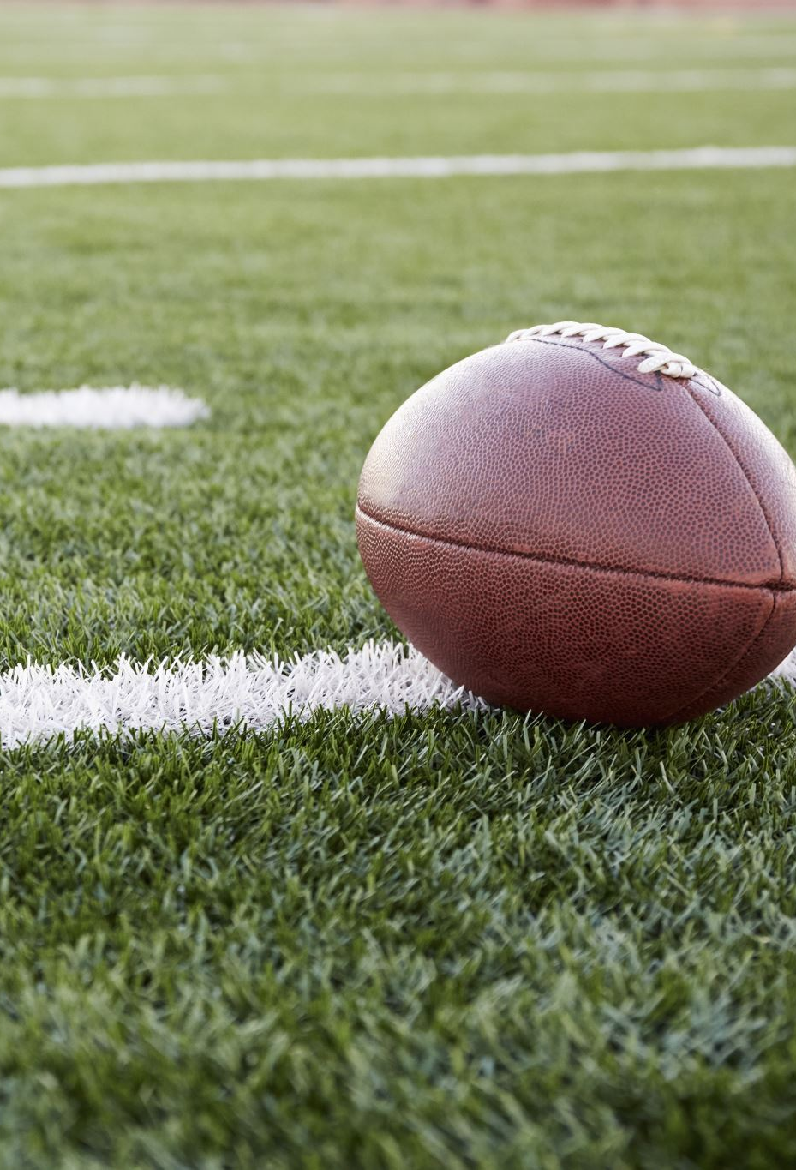
Super Bowl Quarterback Performance
Jarrett Markman

Slide 2
Motivation
Quarterbacks are often referred to as the most important players on an NFL team. Most NFL fans and major news outlets choose to give credit to quarterback performance as why teams are so successful. However, I’m not so sure that is true. In my opinion, oftentimes quarterback can perform at a low to below average level in the postseason and their team will still win. I decided to look at some data from the 2001-2002 NFL Season; in that Super Bowl, Kurt Warner had an EPA/play of -0.11 and Tom Brady had an EPA/play of -0.13. Obviously, those numbers are both bad and close, but it brings up the question of whether quarterback statistics and performance are an accurate measure of team success. Assuming the better quarterback wins, his performance in the Super Bowl should be better than the opposing quarterback. To test this data, I chose to use EPA/play and Passer Rating.

Slide 3
Hypothesis
Either quarterbacks are essential for quarterback success and the statistics available to measure quarterback performance are just not good, or quarterback statistics are good measurements of quarterback skillsets and quarterbacks are not as important in building a team. For example, in this most recent super bowl Matthew Stafford played poorly, but his defense had 8 sacks, held the opposition to 20 points, and Cooper Kupp had 8 catches for 92 Yards and 2 touchdowns. Given a research thesis on what makes a winner in the NFL by Steven Vu, quarterbacks are just not that vital when building a team. Other offensive positions, such as offensive line, wide receivers, and running backs are more vital to team success. The media and many fans attribute team success to quarterback performance and ignore whether the quarterback performance was good, or if the team played well and won due to that.

Slide 4
Research
I chose to compare super bowl qb performance using EPA/play and passer rating.
These are two of the most important statistics in football, and they usually indicate quarterback skill level.
For example, Patrick Mahomes, throughout his career, has very good EPA/play and passer rating numbers, and he is regarded as one of, if not, the best quarterbacks in the NFL.
If these statistics are good indicators of qb success and skill
in the super bowl, the winning quarterback should have better numbers than the losing quarterback;
Or it proves my hypothesis that quarterbacks are not that important in building a winner.
For my research I used mySQL server to put together a table and analyze the data.

Slide 5
EPA/play
EPA/play is a statistic that measures the value of individual plays based on game situation. It’s done by calculating the expected points based on the down, distance and field position at the beginning of a play in contrast to its result. Basically, a point estimation for the points added for a 1st and 10, and if for instance, the quarterback gets sacked for a 10-yard loss, the points added from that play would be negative, lowering the overall EPA. However, if there was a pass for 20 yards and a first down that low expected points added value would increase. This can be seen in an example from Super Bowl XLIII, “After an interception, the Arizona Cardinals take over on the 34 of the Pittsburgh Steelers. They start the drive with a 3.31 EPA, which makes sense, as they are already in field goal range. Two incompletions lower that to 2.08, before a 3rd-and-10 conversion to Tim Hightower raises the EP to 3.97, an EPA of 1.89.” The 3rd down conversion play is valued at 1.89 because that is how many expected points that one play added to the previous estimation.

Slide 6
Data and Observations
I used SQL to create a database for the EPA and Passer Rating data. In my code I had two epa and passer rating values, for instance qb_epa_play_A was the epa/play in the super bowl for the winning qb. I used select and where commands to look for and find data given the winning or losing QB. For instance, to find when the super bowl winning qb had a higher epa/play than the losing qb, or whether the winning qb had a better epa/play AND passer rating than the losing qb.
While there are plenty more ways to use the select and where commands, given what I used:
If we are assuming that quarterbacks are contingent for success, 18/21 super bowl winning qbs had a better epa/play than the losing qb.
There are also 4 qbs with negative expected points added values that ended up winning.
Something that could additionally be tested that I didn’t test is the number of quarterbacks with a better epa than the losing qb that had a negative epa.
The thing I was most focused on testing was the number of winning qbs with a better epa/play AND a better passer rating was only 13/21. If epa and passer rating are both effective quarterback measurement metrics, that number should be a lot higher than ~62%.

Slide 7
sources
Vu, Steven. “.The Era of Analytics in the NFL: Application of Modern Portfolio Theory.” California State University, Long Beach, Fall 2015. https://scholarworks.calstate.edu/downloads/z603qz23h?locale=zh
Archibald, Dave. “Glossary Entry: Expected Points Added.” Inside the Pylon, October 25, 2019. http://insidethepylon.com/football-101/glossary-football-101/2019/10/25/glossary-entry-expected-points-added/
All EPA/play data found: https://rbsdm.com/stats/box_scores/
All passer rating data found: https://www.pro-football-reference.com/boxscores/200202030nwe.htm
https://www.pro-football-reference.com/boxscores/200301260rai.htm
https://www.pro-football-reference.com/boxscores/200402010car.htm
https://www.pro-football-reference.com/boxscores/200502060nwe.htm
https://www.pro-football-reference.com/boxscores/200602050pit.htm
https://www.pro-football-reference.com/boxscores/200702040chi.htm
https://www.pro-football-reference.com/boxscores/200802030nwe.htm
https://www.pro-football-reference.com/boxscores/200902010crd.htm
https://www.pro-football-reference.com/boxscores/201002070clt.htm
https://www.pro-football-reference.com/boxscores/201102060pit.htm
https://www.pro-football-reference.com/boxscores/201202050nwe.htm
https://www.pro-football-reference.com/boxscores/201302030sfo.htm
https://www.pro-football-reference.com/boxscores/201402020den.htm
https://www.pro-football-reference.com/boxscores/201502010sea.htm
https://www.pro-football-reference.com/boxscores/201602070den.htm
https://www.pro-football-reference.com/boxscores/201702050atl.htm
https://www.pro-football-reference.com/boxscores/201802040nwe.htm
https://www.pro-football-reference.com/boxscores/201902030ram.htm
https://www.pro-football-reference.com/boxscores/202002020kan.htm
https://www.pro-football-reference.com/boxscores/202102070tam.htm
https://www.pro-football-reference.com/boxscores/202202130cin.htm
Average passer rating from 2001-2021 found with: https://www.statmuse.com/nfl/ask/average-qb-passer-rating-from-2001-to-2021

